Slide 1
cyber security
Name Bilal abid abbasi
Reg# 45961

Slide 2
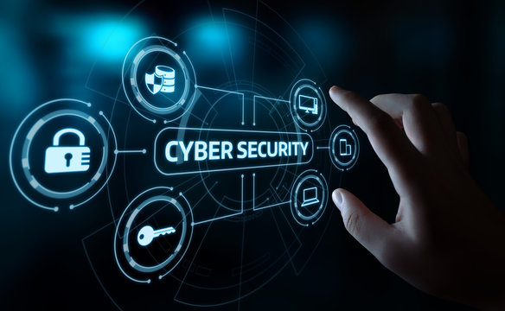
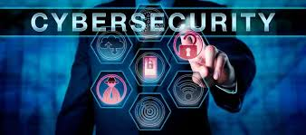
What is cyber security?
Cyber security:
Cyber security is the practice of protecting computer systems, networks, data, and digital services from unauthorized access, attacks, or damage. It covers a wide range of technologies, processes, and best practices designed to defend against both external.
and internal threats
Key Areas of Cyber security
Protecting networks from intrusions with firewalls, intrusion detection systems, and segmentation.
2. Application Security
1. Network Security
Keeping software safe from vulnerabilities through secure coding, testing, and patching.
3. Endpoint Security
Protecting user devices with antivirus, encryption, and mobile device management.
4. Cloud Security
Ensuring cloud data and services are configured securely and monitored.
5. Identity & Access Management (IAM)
Controlling who can access what—using passwords, multifactor authentication, and role-based access.
6. Operational Security (Op Sec)
Policies and procedures that govern how data is handled and protected.

Slide 3
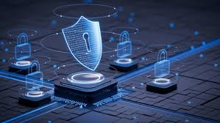
Cyber security
How we Can Improve Their Security
Use strong, unique passwords + a password manager
Enable two-factor authentication (2FA)
Keep devices and software updated
Avoid suspicious links and attachments
Use secure Wi-Fi (avoid public networks without a VPN)
Why is cybersecurity important?
Importance of cyber security
Protects sensitive data (personal, financial, business information) from unauthorized access.
Prevents cyber attacks such as hacking, phishing, ransomware, and malware.
Maintains privacy by ensuring personal information is not misused or exposed.
Ensures business continuity by preventing disruptions and downtime.
Protects financial assets and reduces economic losses caused by cybercrime.
Supports national security by protecting government and military networks.

Slide 4
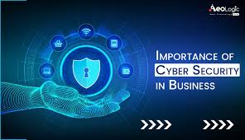
Role of cyber security in business
📘 Table 2: Role of Cybersecurity in Business
📘 Table 2: Role of Cybersecurity in Business
Business Role | Description
Protecting Assets | Secures intellectual property, customer data, and financial resources.
Preventing Downtime | Stops attacks like DDoS that disrupt operations.
Building Customer Trust | Shows users their data is safe, improving reputation.
Regulatory Compliance | Helps companies follow legal and industry security standards.
Reducing Financial Loss | Prevents costly breaches, fines, and operational failures.
Business Role | Description
Protecting Assets | Secures intellectual property, customer data, and financial resources.
Preventing Downtime | Stops attacks like DDoS that disrupt operations.
Building Customer Trust | Shows users their data is safe, improving reputation.
Regulatory Compliance | Helps companies follow legal and industry security standards.
 | Prevents costly breaches, fines, and operational failures.

Slide 5

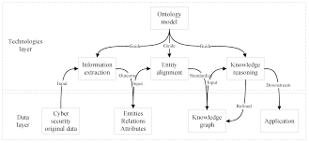
Scope of cyber security
1. Network Security
2. Information Security
3. Application Security
4. Cloud Security
5. Endpoint Security 6. Identity and Access Management (IAM)
6. Identity and Access Management (IAM)

Slide 6
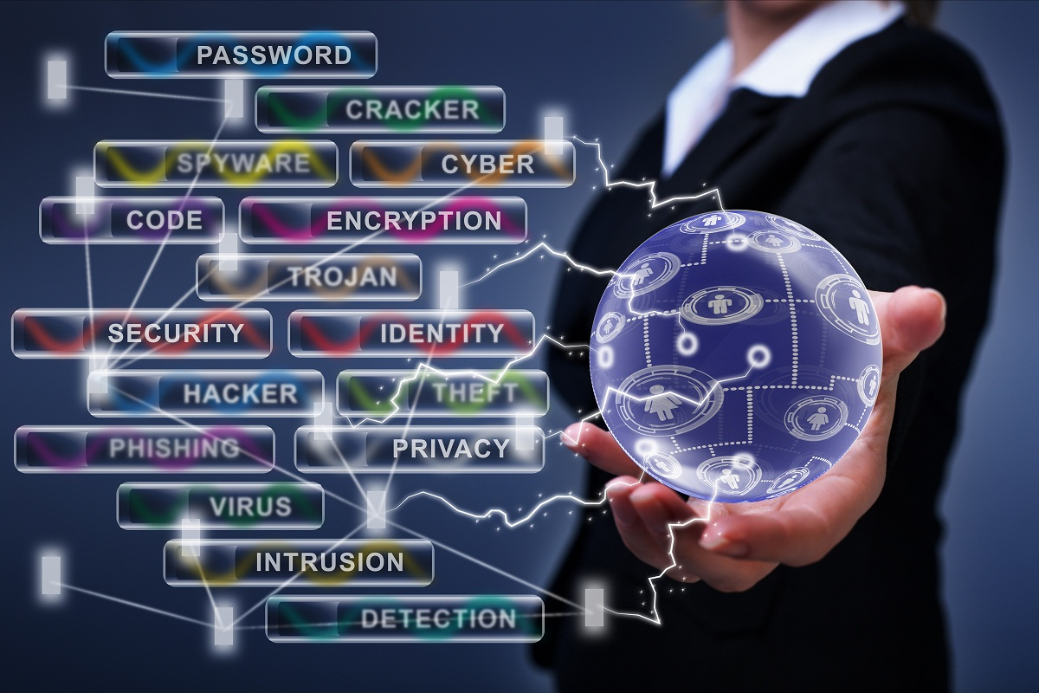
Importance of Cyber Security
🆔 6. Identity and Access Management (IAM)
Cyber security is crucial in today’s digital world because it protects our data, devices, and online activities from attacks. Every individual, business, and government relies on technology, which makes security essential. Here are the main reasons why cyber security is important:

Slide 7
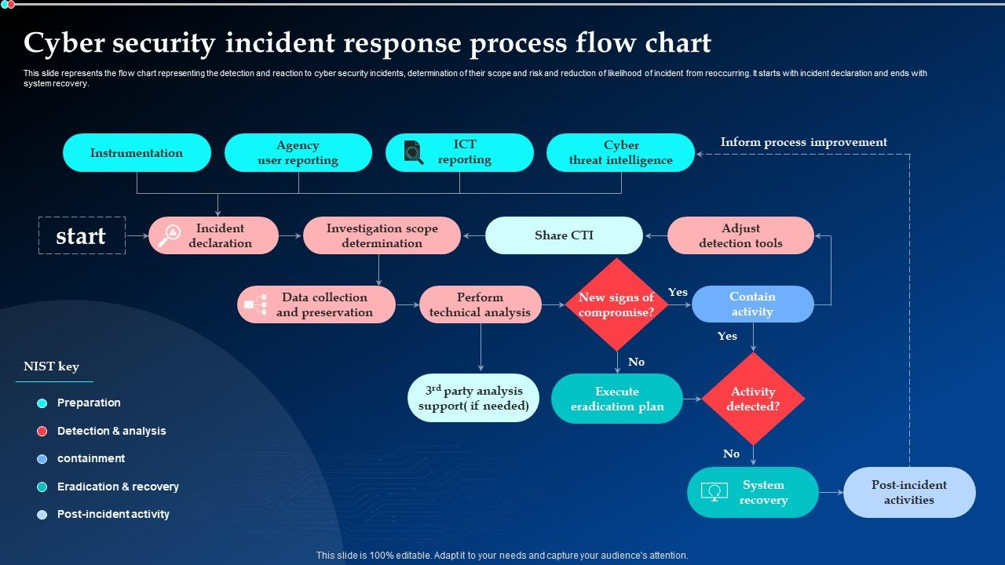
cyber security

